Slide 1
Deep Learning from Scratch
Theory + Practical
FAHAD HUSSAIN
MCS, MSCS, DAE(CIT)
Computer Science Instructor of well known international Center
Also, Machine Learning and Deep learning Practitioner
For further assistance, code and slide https://fahadhussaincs.blogspot.com/
YouTube Channel : https://www.youtube.com/fahadhussaintutorial

Slide 2
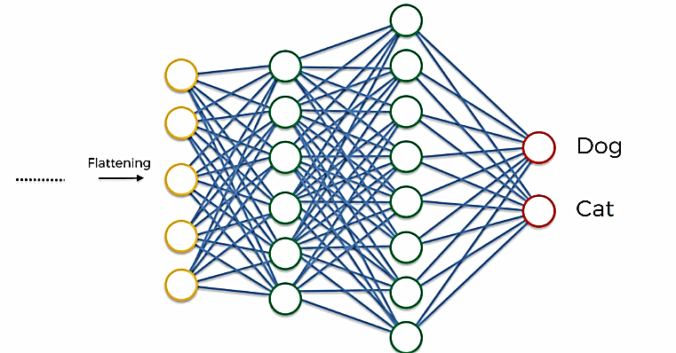
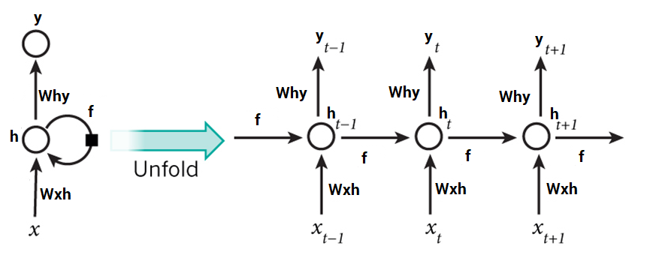
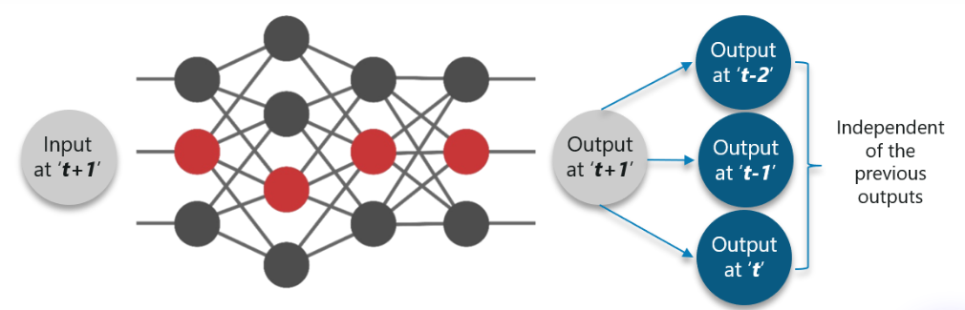
Why RNN and what is difference between
ANN & RNN
This is a cat, and _____
is a good pet animal
For further assistance, code and slide https://fahadhussaincs.blogspot.com/
YouTube Channel : https://www.youtube.com/fahadhussaintutorial

Slide 3
Vanishing gradient problem
The vanishing gradient makes the gradient very close to zero, so it's difficult to know where to move in the state space; the exploding gradient makes the gradient a very large value, so it makes learning unstable. This problem is more pronounced in recurrent networks since they use the same matrix at each time step.
For further assistance, code and slide https://fahadhussaincs.blogspot.com/
YouTube Channel : https://www.youtube.com/fahadhussaintutorial

Slide 4
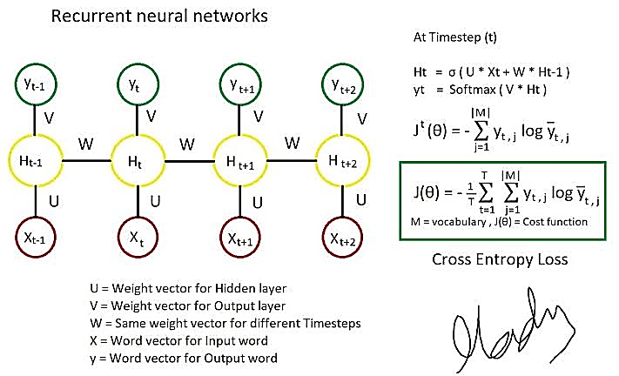
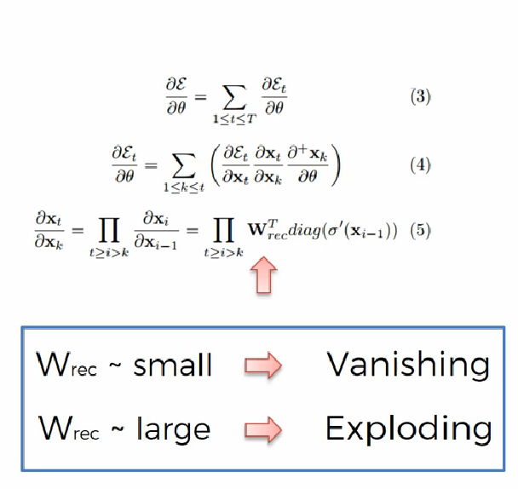
For further assistance, code and slide https://fahadhussaincs.blogspot.com/
YouTube Channel : https://www.youtube.com/fahadhussaintutorial

Slide 5
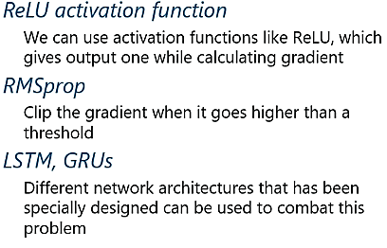
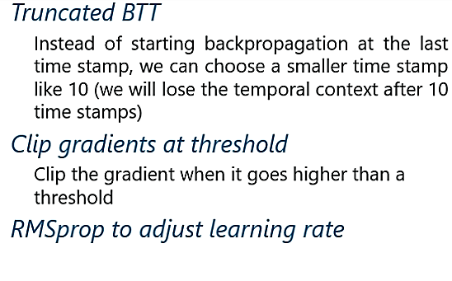
Exploding Gradient:
The working of the exploding gradient is similar but the weights here change drastically instead of negligible change. Notice the small change.
Vanishing Gradient:
When making use of back-propagation the goal is to calculate the error which is actually found out by finding out the difference between the actual output and the model output and raising.
For further assistance, code and slide https://fahadhussaincs.blogspot.com/
YouTube Channel : https://www.youtube.com/fahadhussaintutorial

Slide 6
Do Subscribe the channel for further updates!
Thanks
For further assistance, code and slide https://fahadhussaincs.blogspot.com/
YouTube Channel : https://www.youtube.com/fahadhussaintutorial

Slide 7
Exploding Gradient:
The working of the exploding gradient is similar but the weights here change drastically instead of negligible change. Notice the small change.
Vanishing Gradient:
When making use of back-propagation the goal is to calculate the error which is actually found out by finding out the difference between the actual output and the model output and raising.
For further assistance, code and slide https://fahadhussaincs.blogspot.com/
YouTube Channel : https://www.youtube.com/fahadhussaintutorial

Slide 8
For further assistance, code and slide https://fahadhussaincs.blogspot.com/
YouTube Channel : https://www.youtube.com/fahadhussaintutorial

Slide 9
Basic LSTM
Long short-term memory network was first introduced in 1997 by Sepp Hochreiter and his supervisor for a Ph.D. thesis.
LSTM is a special kind of RNN, capable of learning long term dependencies.
Remembering information for long period of time is it’s default behaviour.
Long short-term memory (LSTM) network is the most popular solution to the vanishing gradient problem.
For further assistance, code and slide https://fahadhussaincs.blogspot.com/
YouTube Channel : https://www.youtube.com/fahadhussaintutorial

Slide 10
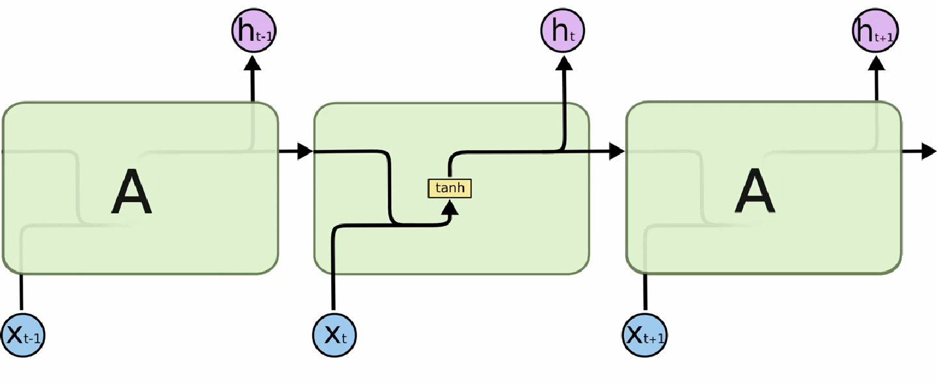
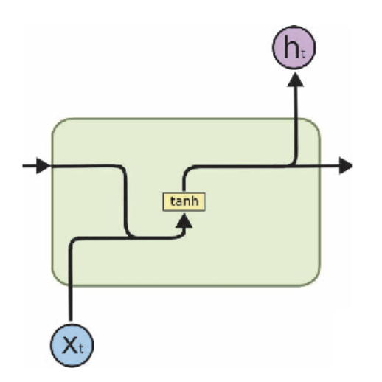

Slide 11
First Understand the RNN Works
This is a cat, and _____ is a good pet animal
For further assistance, code and slide https://fahadhussaincs.blogspot.com/
YouTube Channel : https://www.youtube.com/fahadhussaintutorial

Slide 12
Looking More Clearly
For further assistance, code and slide https://fahadhussaincs.blogspot.com/
YouTube Channel : https://www.youtube.com/fahadhussaintutorial

Slide 13
Looking More Clearly
For further assistance, code and slide https://fahadhussaincs.blogspot.com/
YouTube Channel : https://www.youtube.com/fahadhussaintutorial

Slide 14
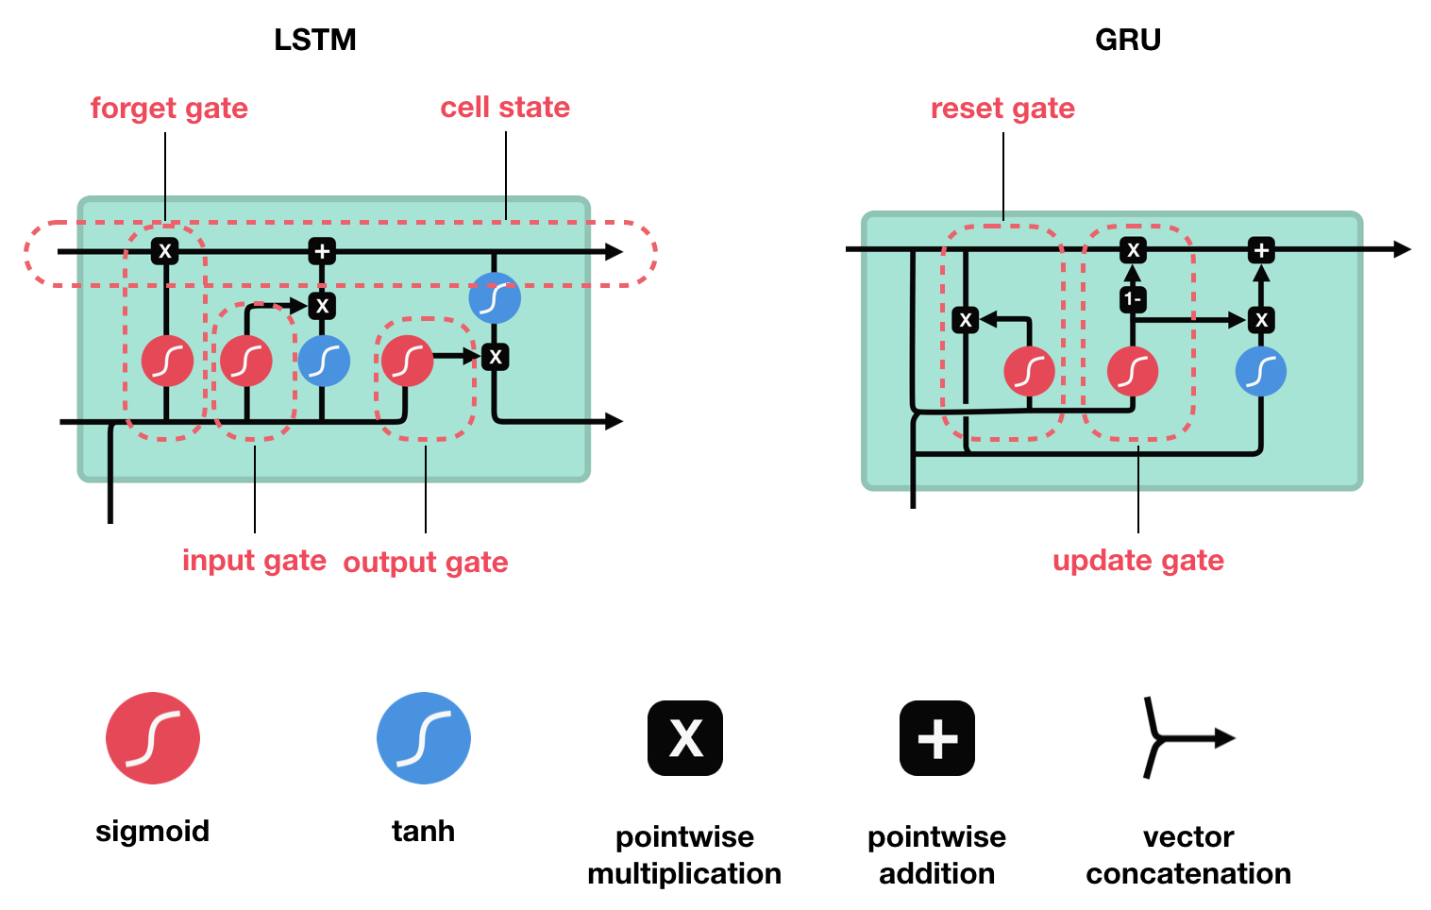
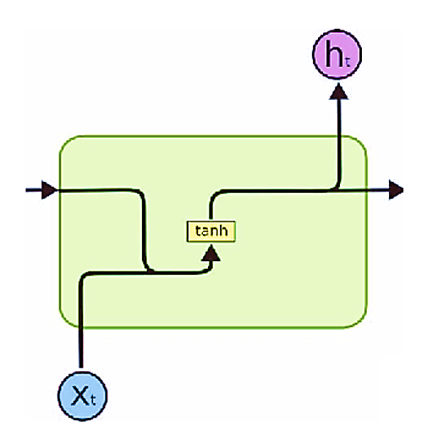
LSTM’s and GRU’s as a solution
LSTM ’s and GRU’s were created as the solution to short-term memory. They have internal mechanisms called gates that can regulate the flow of information.

Slide 15
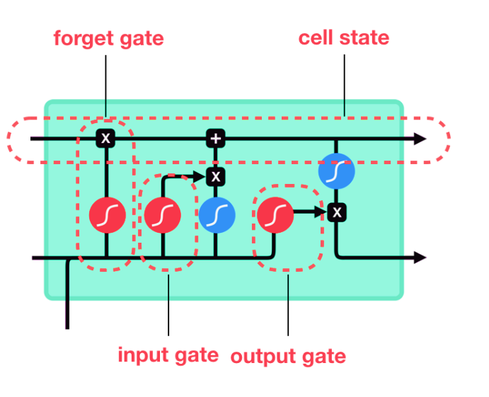
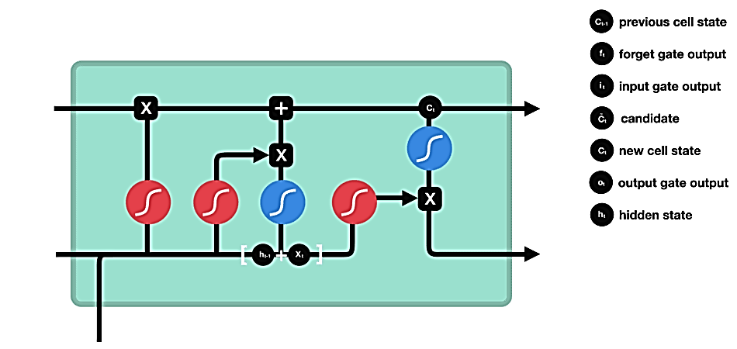
LSTM’s as a solution
For further assistance, code and slide https://fahadhussaincs.blogspot.com/
YouTube Channel : https://www.youtube.com/fahadhussaintutorial

Slide 16
LSTM’s as a solution (steps)
First, the previous hidden state and the current input get concatenated. We’ll call it combine.
2. Combine get’s fed into the forget layer. This layer removes non-relevant data.
4. A candidate layer is created using combine. The candidate holds possible values to add to the cell state.
3. Combine also get’s fed into the input layer. This layer decides what data from the candidate should be added to the new cell state.
5. After computing the forget layer, candidate layer, and the input layer, the cell state is calculated using those vectors and the previous cell state.
6. The output is then computed.
7. Pointwise multiplying the output and the new cell state gives us the new hidden state.

Slide 17
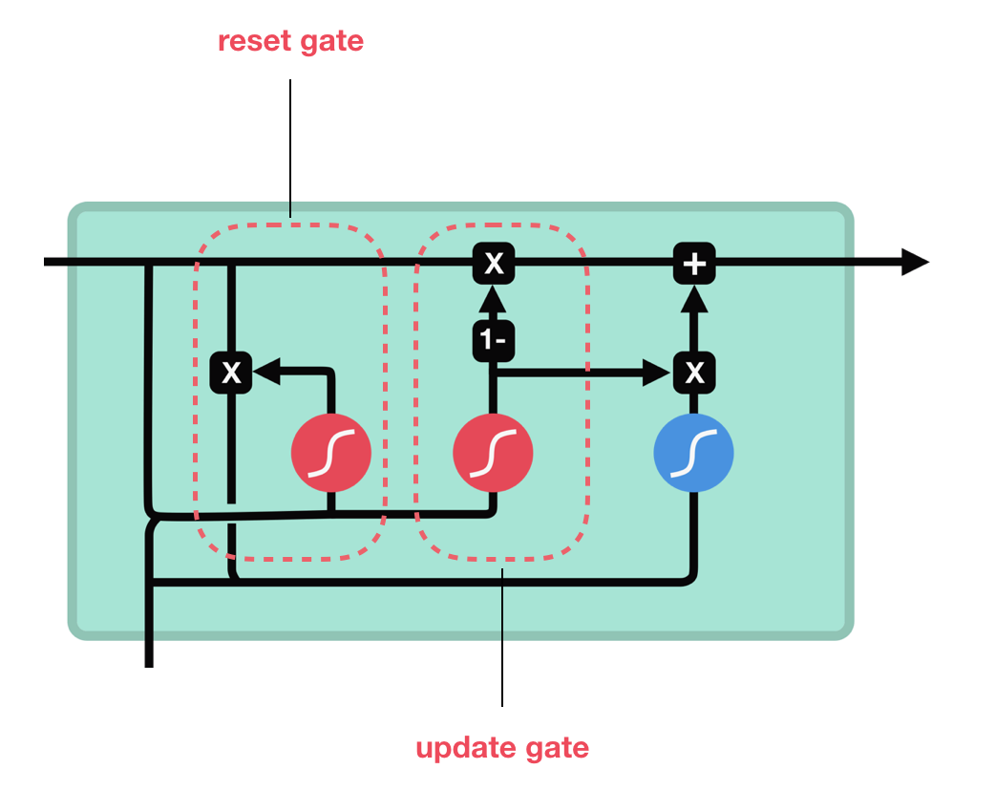
GRU’s () Gated Recurrent Unit, as a solution
Now we know how an LSTM work, let’s briefly look at the GRU. The GRU is the newer generation of Recurrent Neural networks and is pretty similar to an LSTM. GRU’s got rid of the cell state and used the hidden state to transfer information. It also only has two gates, a reset gate and update gate.
For further assistance, code and slide https://fahadhussaincs.blogspot.com/
YouTube Channel : https://www.youtube.com/fahadhussaintutorial

Slide 18
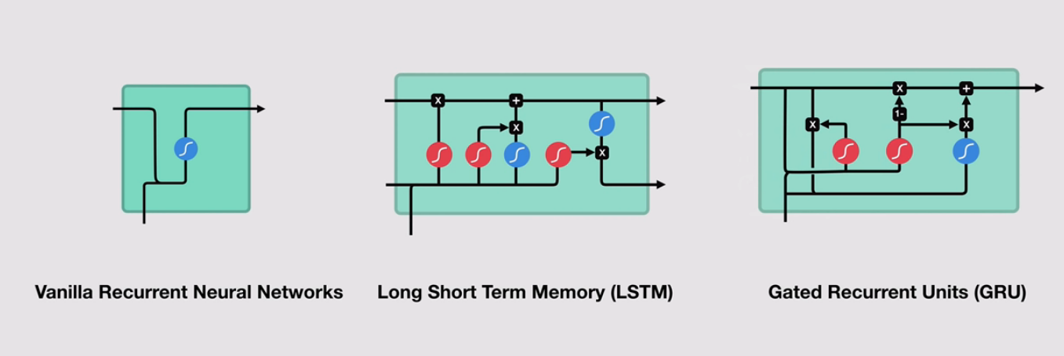
RNN vs LSTM vs GRU
For further assistance, code and slide https://fahadhussaincs.blogspot.com/
YouTube Channel : https://www.youtube.com/fahadhussaintutorial

Slide 19
RNN vs LSTM vs GRU
The key difference between a GRU and an LSTM is that a GRU has two gates (reset and update gates) whereas an LSTM has three gates (namely input, output and forget gates).
GRUs train faster and perform better than LSTMs on less training data if you are doing language modeling (not sure about other tasks).
GRUs are simpler and thus easier to modify, for example adding new gates in case of additional input to the network. It's just less code in general.
LSTMs should in theory remember longer sequences than GRUs and outperform them in tasks requiring modeling long-distance relations.

Slide 20
Blog:
http://colah.github.io/posts/2015-08-Understanding-LSTMs/
Research Papers:
LSTM: A Search Space Odyssey
Deep Learning for Solar Power Forecasting – An Approach Using Autoencoder and LSTM Neural Networks
Thanks
For further assistance, code and slide https://fahadhussaincs.blogspot.com/
YouTube Channel : https://www.youtube.com/fahadhussaintutorial

